Slide 1
MagNet: a Two-Pronged Defense against Adversarial Examples
Proceedings of the 2017 ACM SIGSAC Conference on Computer and
Communications Security. ACM, 2017.
Dongyu Meng and Hao Chen.

Slide 2
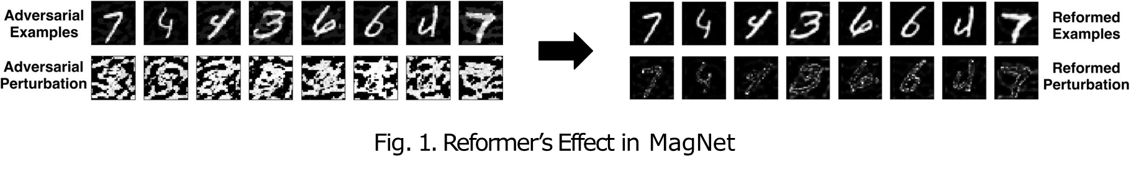
Problems & Solutions
Problem: Defend ML models against adversarial examples.
Solutions: MagNet
A defense tool that detects or reforms adversarial examples
Test Results: Successfully detected or reformed the examples
ex) Images used in image classification problems

Slide 3
Contributions of the Paper
Formally defines adversarial examples
Including metrics for evaluating defenses
Proposes general defense against adversarial examples
Independent to the target classifier to protect
Independent to the process to generate adversarial examples
Proposes graybox attack model
Claims that graybox is a reasonable attack level to consider for defenses
Proposes diversity-based defense against graybox attacks

Slide 4
Paper Meanings
The authors could build defense elements corresponding to the each causes of adversarial examples
The resulting defense, which is a combination of detectors and reformer, provides simple but strong protection against known adversarial example generators

Slide 5
Adversarial Examples
Normal examples for a task: examples occurring naturally
Adversarial examples: examples that
Not a normal example
Classifier’s decision disagrees with human’s prevailing judgment

Slide 6

Adversarial Examples (Formal)
𝕊: Set of all examples, ℂ𝑡: Set of classes for the task 𝑡
Normal examples for the task 𝑡: ℕ𝑡
ℕ_{𝑡} = 𝑥 𝑥 ∈ 𝕊, 𝑝(𝑥) 𝑖𝑠 𝑛𝑜𝑛 − 𝑛𝑒𝑔𝑙𝑖𝑔𝑖𝑏𝑙𝑒}
𝑝(𝑥) : Pr( Natural data generation process for the task emits 𝑥 )
Classifiers 𝑓_{𝑡}: 𝕊 → ℂ_{𝑡} , Ground Truth Classifier 𝑔_{𝑡}: 𝕊 → ℂ_{𝑡} ∪ {⊥}
Adversarial example 𝑥 for 𝑓_{𝑡} satisfies:
𝑥 ∈ 𝕊 ∖ ℕ (Not a normal example)
𝑓_{𝑡} (𝑥) ≠ 𝑔_{𝑡} (𝑥) (Classifier’s decision disagrees with the ground truth)
‘None of the classes’ symbol

Slide 7
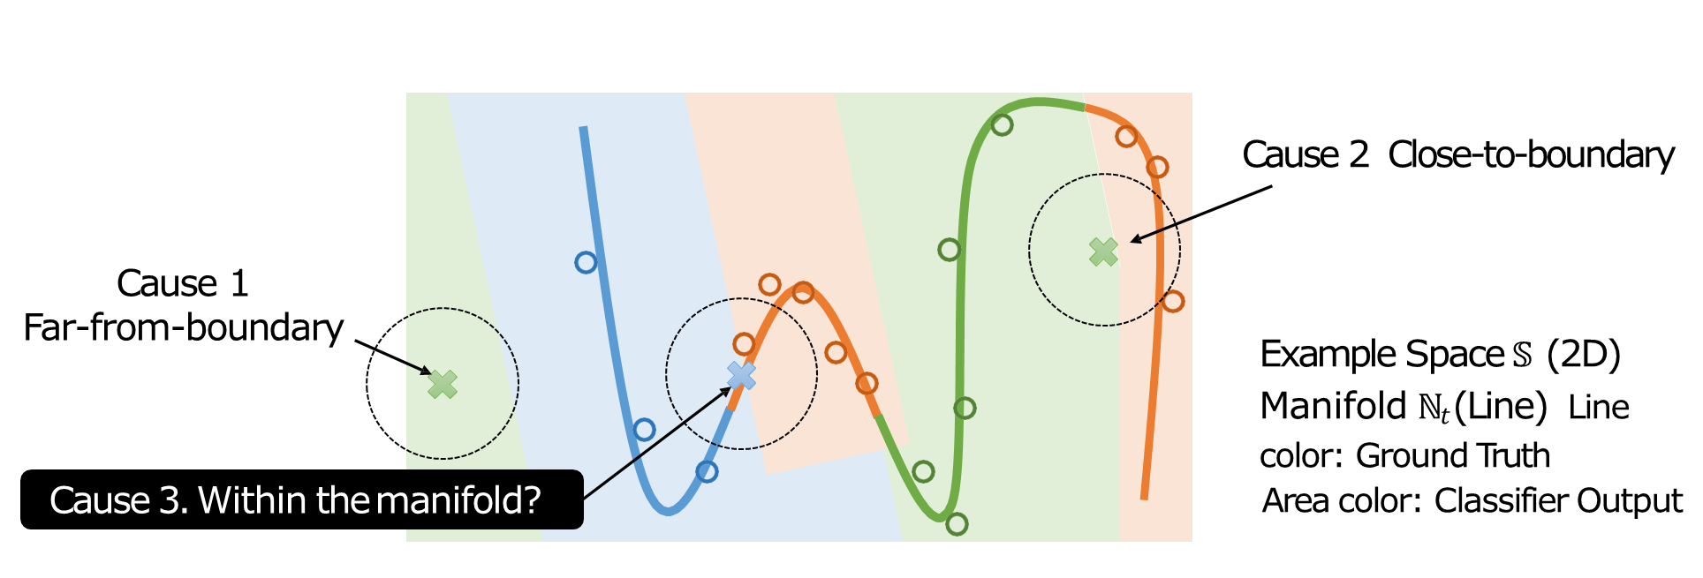
Causes of Adversarial Examples
Adversarial examples can be far from the boundary of task manifold ℕ𝑡. (cf: Blank Image for digit classification task)
Adversarial examples can be close to the boundary of the manifold.

Slide 8
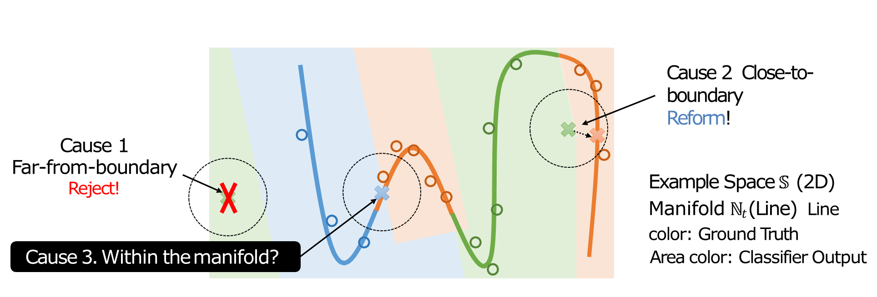
Causes of Adversarial Examples
Adversarial examples can be far from the boundary of task manifold ℕ_{𝑡}. (cf: Blank Image for digit classification task)
Adversarial examples can be close to the boundary of the manifold.

Slide 9
Existing Attacks
Fast Gradient Sign Method (FGSM)
One-step generation based on gradient sign of loss function
Every data (pixels in the case of images) become either incremented or decremented by small 𝜖.
Iterative Gradient Sign Method
Using smaller steps than FGSM, and iterates the process.
Clips according to distance 𝜖, ensuring the perturbation within that boundary.

Slide 10
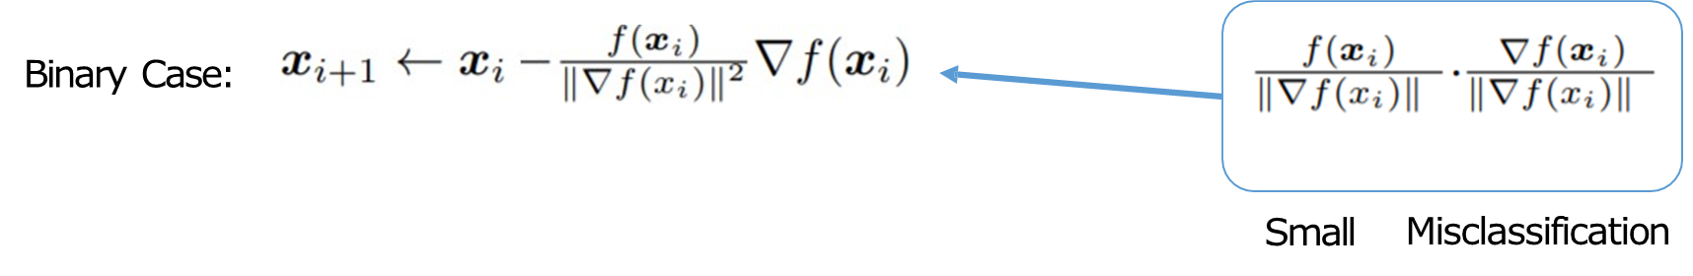

Existing Attacks
Let 𝑓(𝑥) a function that 𝑓(𝑥)< 0 iff 𝑥 is classified incorrectly.
DeepFool
Finds nearest boundary and performs a variant of Newton’s method.
Iterative method, which extended into multiclass differentiable classifiers
Carlini’s Attack
Solves an optimization problem on 𝛿, minimizing
Here, hinge-loss with confidence 𝜅 is picked as 𝑓(𝑥).
𝑐 : Balancing hyperparameter

Slide 11
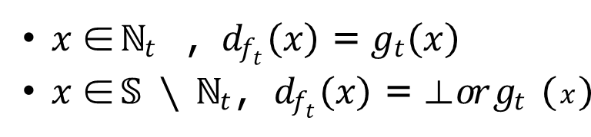
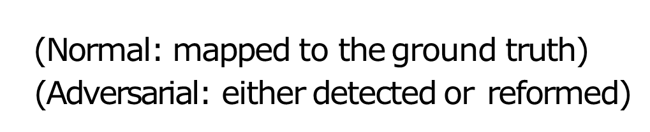
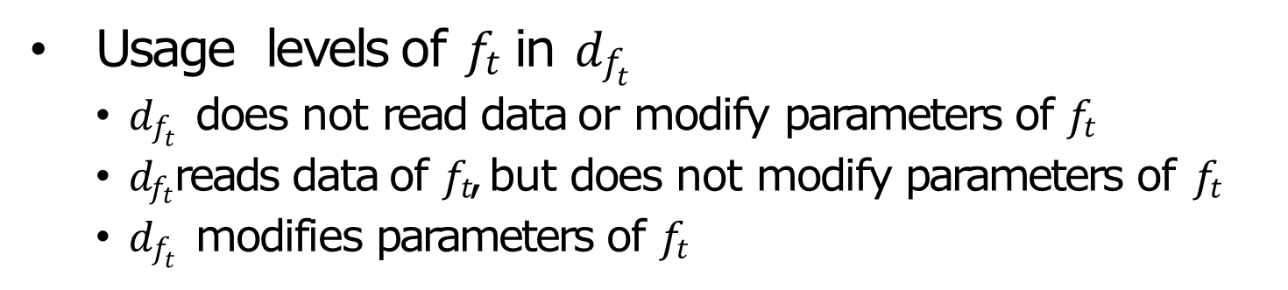

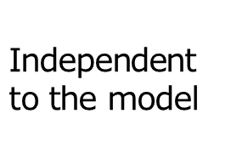
Defenses (Formal)
Defense 𝑑_{𝑓 ∶ 𝕊 → ℂ𝑡 ∪ {⊥}} (An extended classifier)
Defense 𝑑_{𝑓} is correct if

Slide 12
Existing Defenses
Adversarial Training
Augments adversarial data with correct classes, to the training input.
Defensive Distillation
Hides the gradient between the pre-softmax layer and the outputs.
Bypasses: proper loss function, calculation on pre-softmax layer, …
Adversarial Example Detection
Detectors: Binary classifiers to decide adversarial inputs
MagNet approach: Learns manifolds of the normal examples

Slide 13
Threat Model on Defenses
Attackers want to forge examples bypassing the defenses.
Attack classification, based on attackers’ knowledge
Knowledge on 𝑑_{𝑓} 𝑡 | Blackbox Attack | Graybox Attack | Whitebox Attack
Oracle of 𝑑_{𝑓} 𝑡 | O | O | O
Parameters | X | X | O
Model Structures, Hyperparameters, Training set/epoch, Other non-parameters | X | O | O
Random Seed | X | X | O

Slide 14
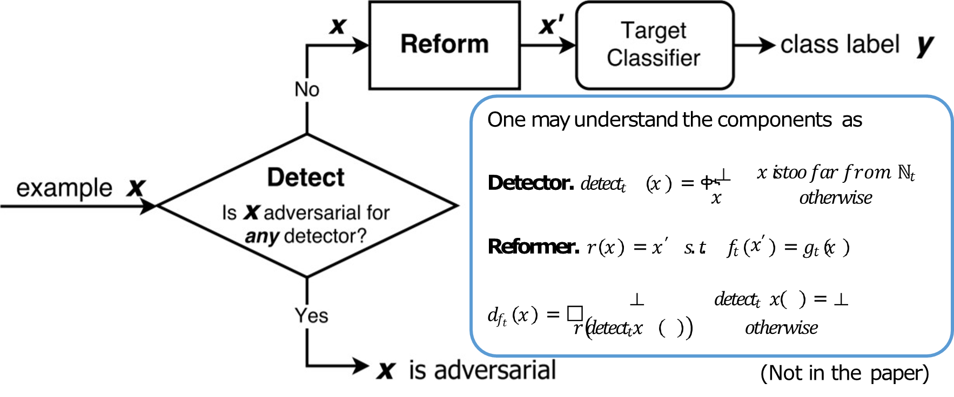
MagNet: Overall Structure

Slide 15
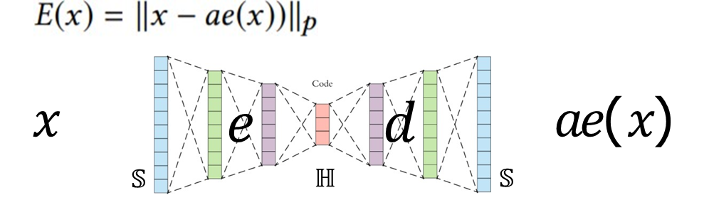

Autoencoders (AEs)
An autoencoder 𝑎𝑒 = 𝑑 ∘ 𝑒
Encoder 𝑒 ∶ 𝕊 → ℍ , Decoder 𝑑 ∶ ℍ → 𝕊
L^{p} reconstruction error
Training autoencoders
Minimize a loss function over the training set
Loss function: Average L² reconstruction error over the training set
(ℍ : Hidden Representation)

Slide 16
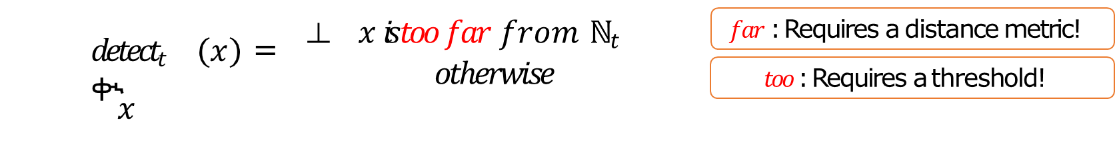
MagNet Detectors
Detector.
Detectors need to measure the example’s distance from ℕ_{𝑡}
Detectors based on AEs’ reconstruction error
The authors expect larger reconstruction error for data with different generation process than the normal data
𝑡_{𝑓𝑝} : Threshold of reconstruction error to decide far-from-manifold data

Slide 17
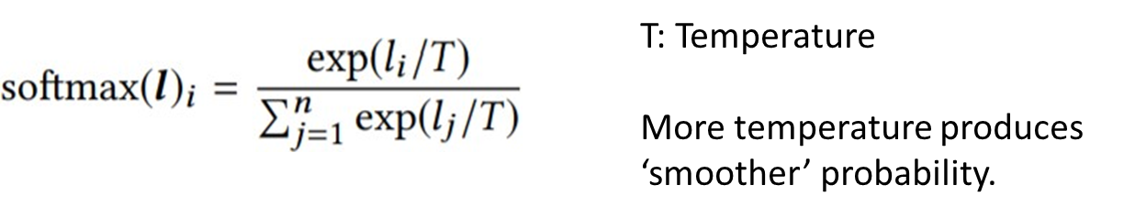
MagNet Detectors
Detectors based on probability divergence
Takes advantage of the target classifier
Compares probability mass functions of original and autoencoded data
Uses Jenson-Shannon divergence on softmaxed probability with temperature

Slide 18
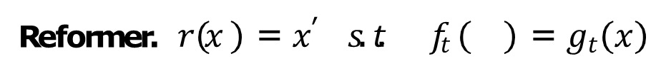

MagNet Reformers
Noise-based Reformer
Adds some noises from normal distributions, and clips the data.
AE-based Reformer
Autoencoders can be used as the reformers directly.

Slide 19
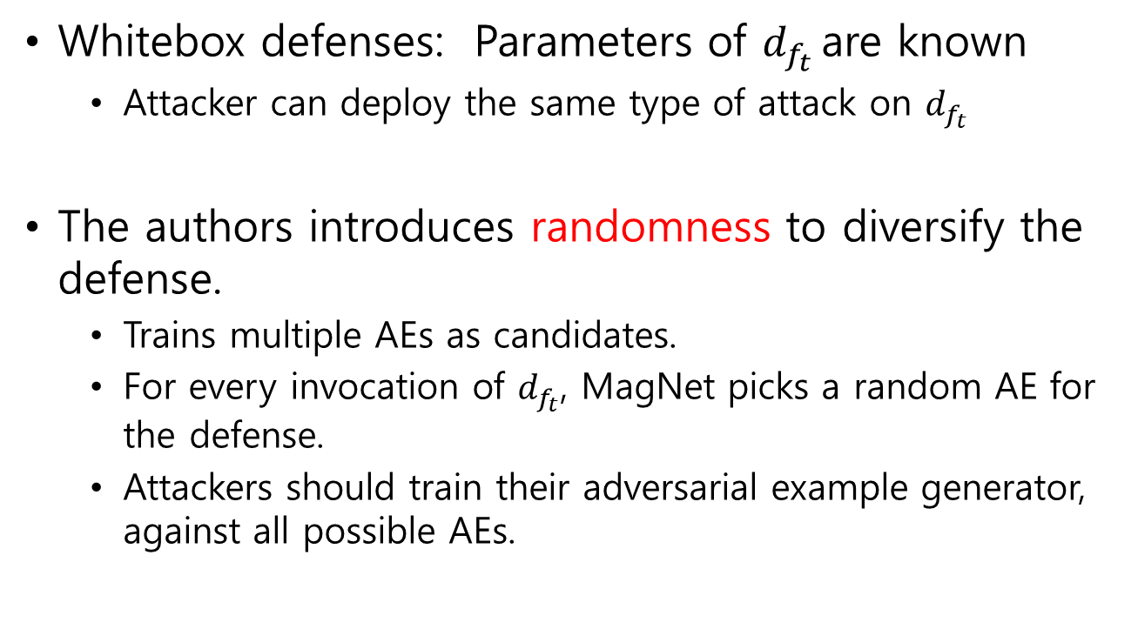
Diversity: Mitigating Graybox Attacks
Whitebox defenses: Parameters of $d_{f_{t}}$ are known
Attacker can deploy the same type of attack on $d_{f_{t}}$
The authors introduces randomness to diversify the defense.
Trains multiple AEs as candidates.
For every invocation of $d_{f_{t}}$, MagNet picks a random AE for the defense.
Attackers should train their adversarial example generator, against all possible AEs.

Slide 20
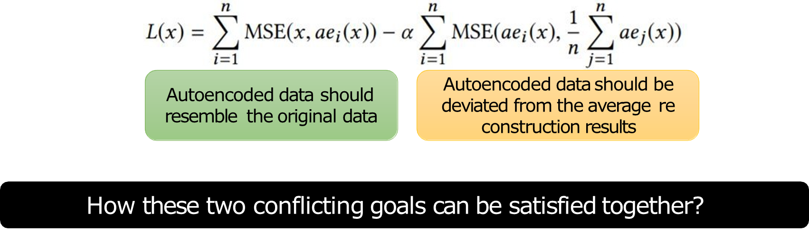
Diversity: Mitigating Graybox Attacks
Finding diverse AEs
Random initialization
Penalize resemblance of AEs by adding the regularization term

Slide 21
Evaluation Steps
Train target classifiers to be defended by MagNet.
Deploy the known attacks to generate adversarial examples.
Construct defensive devices using autoencoders.
Measure classification accuracy of the normal/adversarial examples.

Slide 22
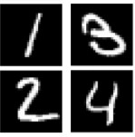
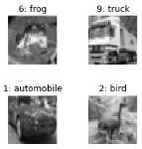
Target Classifiers to Defend
CNN models for two image 10-classification tasks
MNIST: Handwritten Digit Recognition
CIFAR10: Object Classification
Different network and data settings
Following architectures in previous works
Optimized using SGD with learning rate 0.01

Slide 23
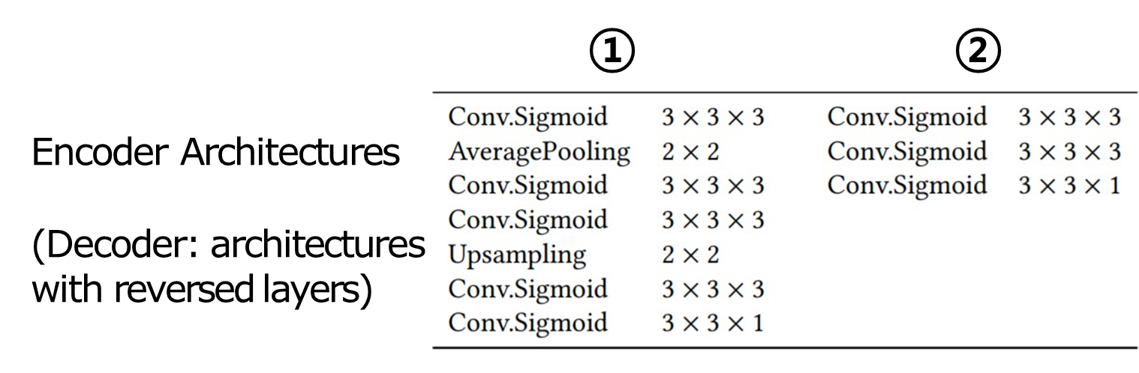
Detector and Reformer Setup
MNIST: ① for detector/reformer, ② for detector only
CIFAR-10: ② for detector/reformer

Slide 24
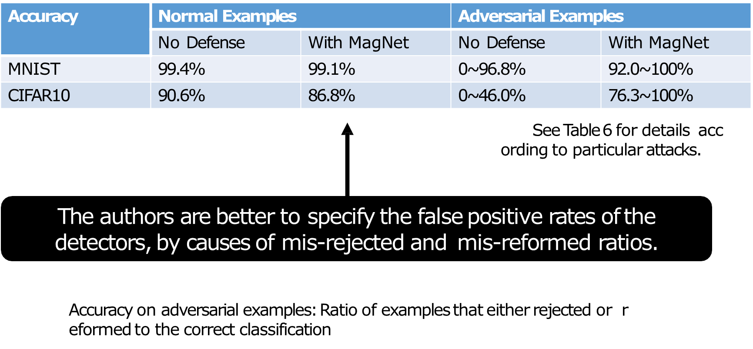
Result: Effects on examples

Slide 25
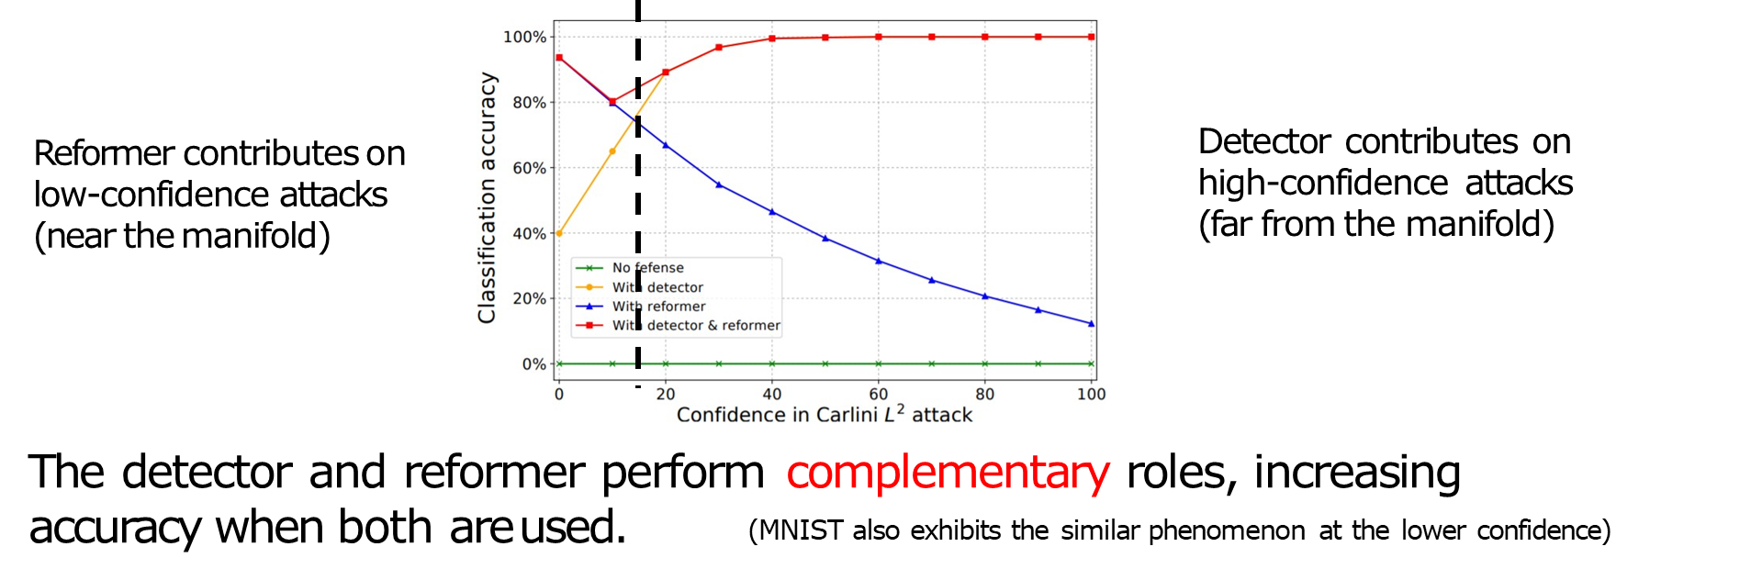
Case Study on Carlini Attack (CIFAR-10)
More confidence in Carlini Attack
→ Adversarial examples farther from the task manifold

Slide 26
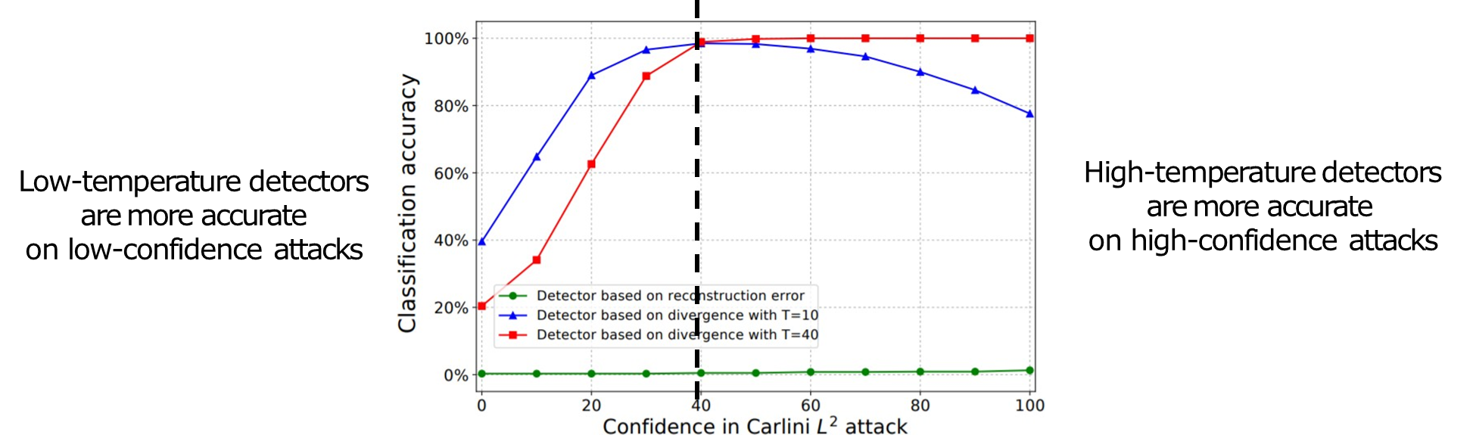
Case Study on Carlini Attack (CIFAR-10)
Effect of temperature on prob. divergence based detectors
→ More temperature means softer mass functions

Slide 27
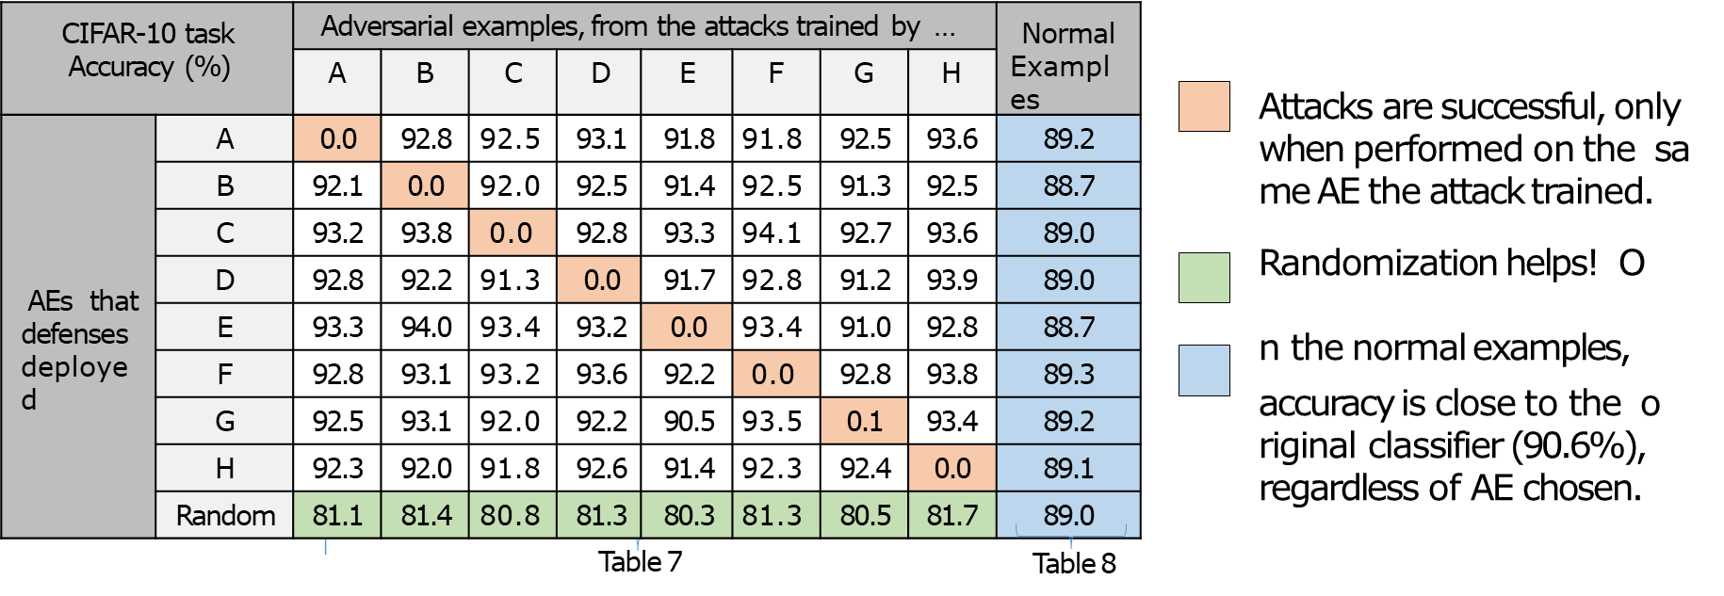
Defense against Graybox Attacks
Classification accuracy table for Carlini’s attack, in the experiment on 8 AEs for CIFAR-10 task

Slide 28
Pros
The authors provide simple but effective architecture.
Tested the defense against state-of-art adversarial example generators, with different norms and parameters.

Slide 29
Cons
The authors do not explain things that make the defense dependent to the models.
How can we define generic, proper distance model on two non- image data?
How can we extract measures of probability divergence from non- NN models?
Weak Quantitative Reasonings:
Why Autoencoders can be used as the reformers: better to provide some comparison of autoencoders with other suggested reformer.
Consequences of AE reuse on both detectors and reformers.

Slide 30
Future Work Suggestions
Correlation analysis between performance of AEs and defense accuracy
Extension to tasks with non-NN models

Slide 31
Questions

